Slide 1
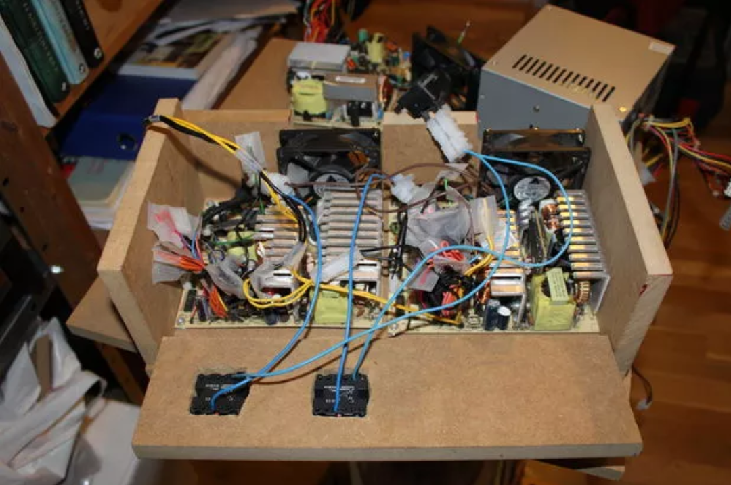
Power Supplies 101 DC-DC Converters
10-Feb-2018

Slide 2
Tonight’s Agenda
Quick primer on circuit components and basic calculations
Examples of unregulated linear supplies
How regulated linear supplies work
How switching supplies work
Some notes on capacitors
Cover related issues that you’re likely to encounter

Slide 3
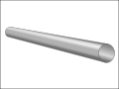
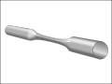
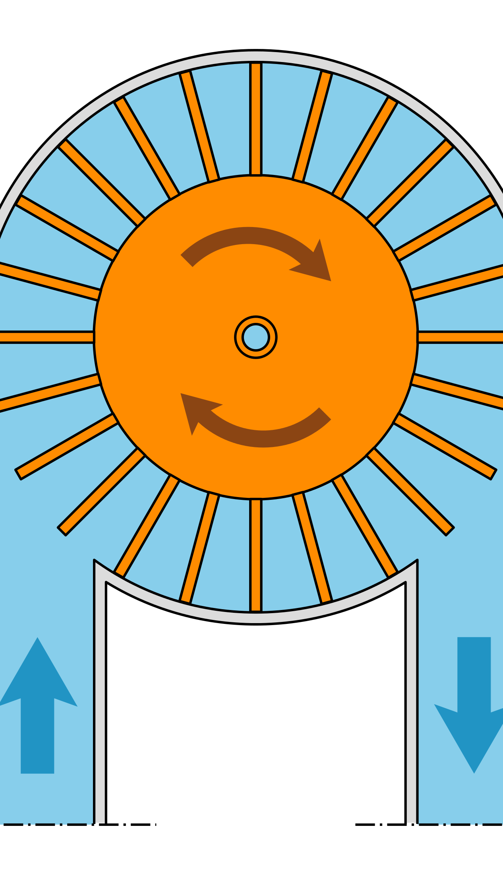
Quick circuit component primer
Wire – carries electrical current like a pipe carries water
Voltage – like the pressure of water in a pipe or air in a tire
Current – the amount of water flowing through a specific cross section of the pipe
Resistor – resists the flow of current, like a constriction in a pipe
Capacitor – stores energy like a hydraulic accumulator
Inductor – stores energy like a heavy paddlewheel

Slide 4
Power supply math primer
Power (P, watts, W) = Voltage (volts, V) x Current (amps, A)
Power = 5V x 2A = 10W
Ohm’s Law:
V = I x R
or: I = V / R
or: R = V / I
V = voltage, volts, V
I = current, amps, A
R = resistance, Ohms, Ω
Units:
1000 milli = 1.0
400mA = 0.4A
10mV = 0.01V
2000 mΩ = 2Ω

Slide 5
Examples
What is the power rating of a 5V, 2A power supply?
Power = Voltage x Current
5V x 2A = 10W
How much current does a 60W light bulb draw?
Current = Power / Voltage
60W / 120V = 0.5A
A 100Ω resistor is connected between a 12V supply and ground, how much current does it draw?
I = V / R
= 12V / 100Ω = 0.12A = 120mA
How much power does it dissipate?
Power = Voltage x Current
= 12V x 120mA = 1.44W
5V @ 2A
Power?
120V
60W bulb
I?
12V
I?

Slide 6
Simple Voltage Converter/Supply
Example: 12V to 5V, 10mA load
R1 = 70Ω
R2 = 50Ω
I_{BIAS} = 100mA
V_{OUT, NO LOAD} = 5.0V
V_{OUT, 10mA LOAD} = 4.7V
Load regulation = 6%
Efficiency = 9.6%
12V
R1
I_{BIAS}
V_{OUT} = R2/(R1+R2)
R2
I_{LOAD}

Slide 7
Zener Voltage Reference/Supply
Decent load regulation ~2-5%
Efficiency ~30%
12V
R1
I_{BIAS}
V_{OUT=}V_{ZENER}
I_{LOAD}

Slide 8
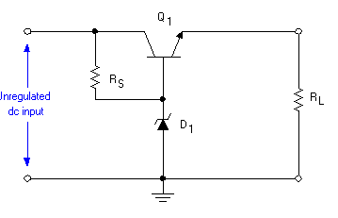
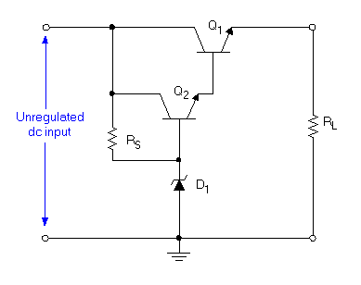
More unregulated supplies

Slide 9
How does a linear regulator work?
V_{IN}
V_{OUT}
e.g. 12V
e.g. 5V
Resistor converts extra voltage into heat
V_{OUT} will be less than V_{IN}
Efficiency = V_{OUT}/V_{IN}
5V / 12V = 42%
3.3V / 5V = 66%

Slide 10
Add a control loop
V_{IN}
V_{OUT}
Stuff
Reference
Voltage

Slide 11
Make it more real
V_{IN}
V_{OUT}
-
+
1.2V
Reference

Slide 12
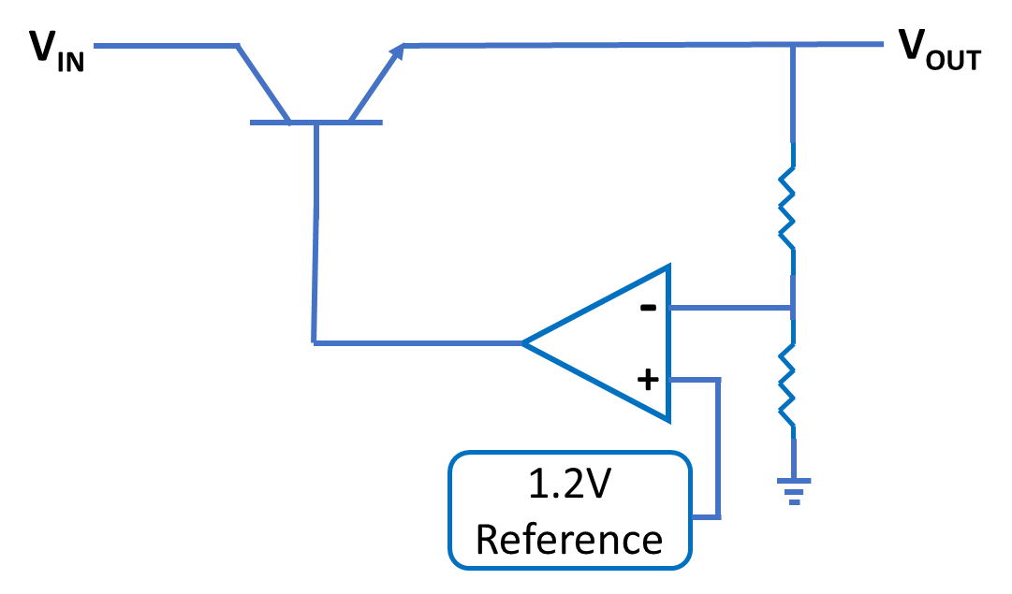
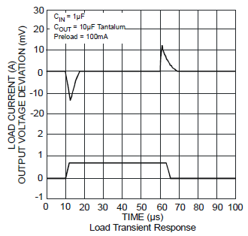
Linear regulator in action
https://www.diodes.com/assets/Datasheets/AP1117.pdf

Slide 13
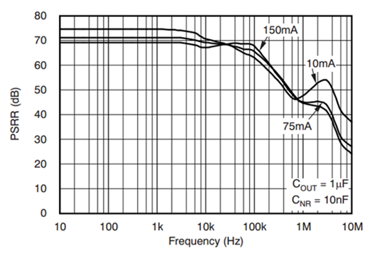
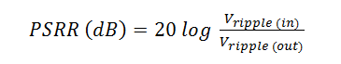
Power Supply Rejection
20dB = 1/10
40dB = 1/100
60dB = 1/1000
70dB = 1/3162 -> Vin ripple of 1V results in 0.3mV at Vout
https://e2e.ti.com/blogs_/b/powerhouse/archive/2017/03/03/ldo-basics-power-supply-rejection-ratio

Slide 14
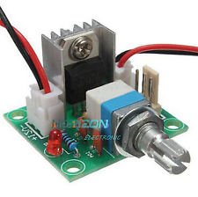
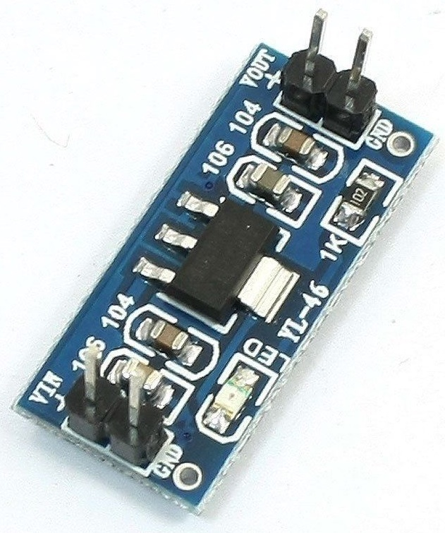
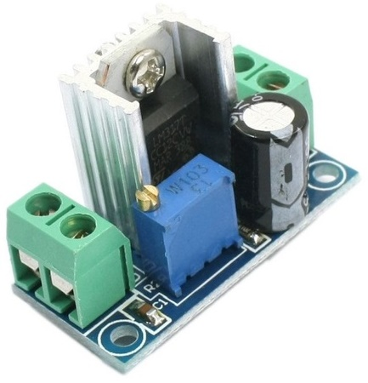
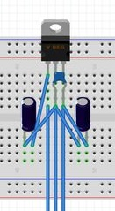
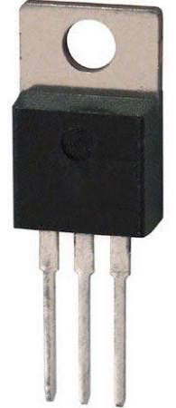
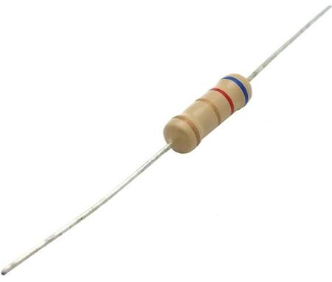
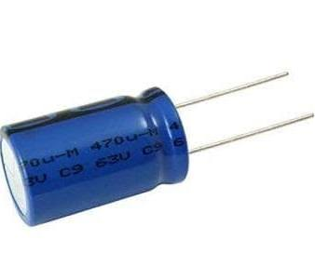
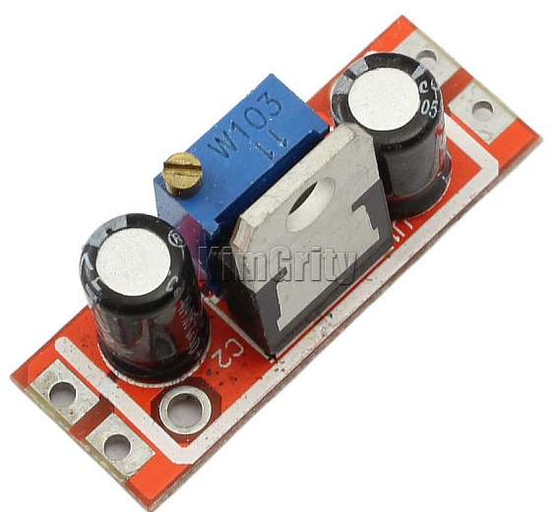
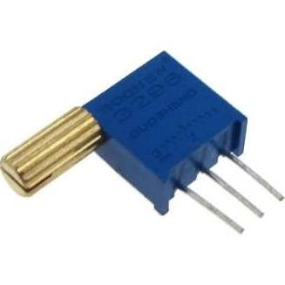
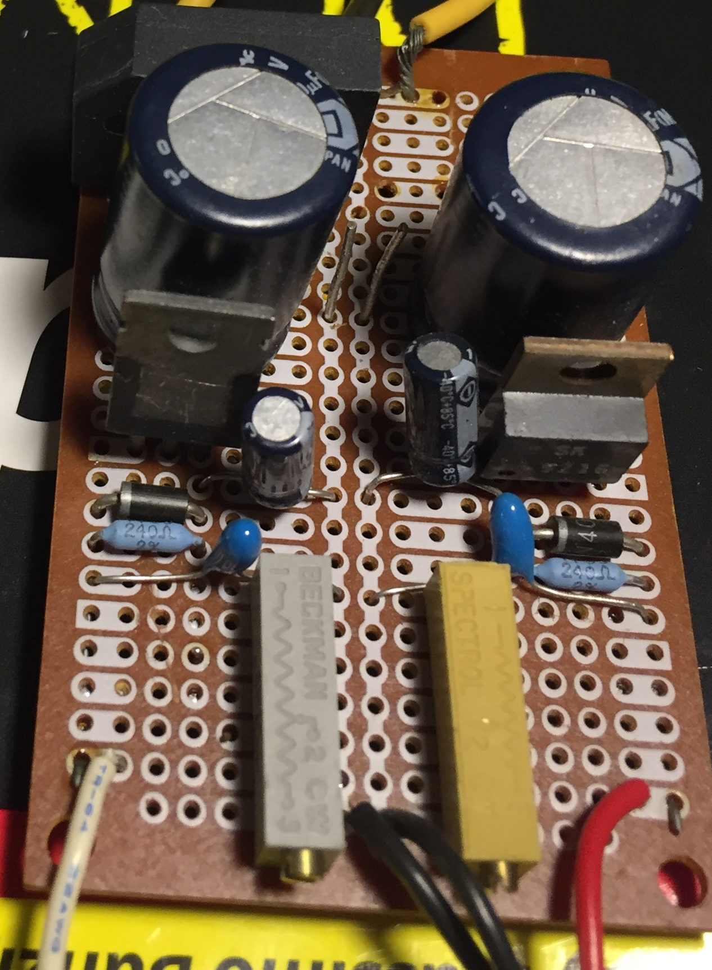
Typical Hardware
$0.99
$1.60
$1.50
$0.50
$0.05
$0.50-$1.00
@mikew
$1.00
$1.70

Slide 15
Workhorse linear regulators ICs
 | V_{IN} Max | V_{OUT} Range | V_{DO} Dropout | Peak I_{OUT}
LM317 | V_{OUT} + 40V | 1.25V to 37V | 3V | 1.5A
LM1117 | 15V | 1.25V to 13.8V | 1.3V | 1A
LM7812 | 35V | 12.0V | 2V | 2.2A
LM7805 | 35V | 5.0V | 2V | 2.4A
LM7833 | 36V | 3.3V | 2V | 1.8A
These regulators are available from multiple manufacturers. Check the data sheet for the specific part you’re looking at.

Slide 16
DC-DC Switching Supplies
Buck converter: V_{OUT} < V_{IN}
Very plentiful selection of products
Boost converter: V_{OUT} > V_{IN}
Inductor-less Charge Pump, typically 10’s of mA
Inductor based boost converter, any current
Buck/Boost converter: V_{OUT} >= or <= V_{IN}
Useful in battery powered circuits where the battery voltage starts above the required voltage but ends below it
e.g. LED flashlight

Slide 17
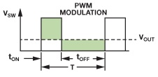
How does a buck regulator work?
12V
DutyCycle = t_{on}/T
V
time
V
5V
V_{IN}
time
Filter
V_{OUT}
V_{OUT} = V_{IN} x DutyCycle

Slide 18
Add a control loop (regulation)
V_{IN}
Filter
V_{OUT}
Clock/
Logic/
Stuff
Reference
Voltage

Slide 19
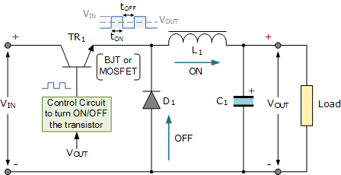
Make it more real
Filter
Could be a FET
Quality of TR1, D1 and L1 affect Efficiency

Slide 20
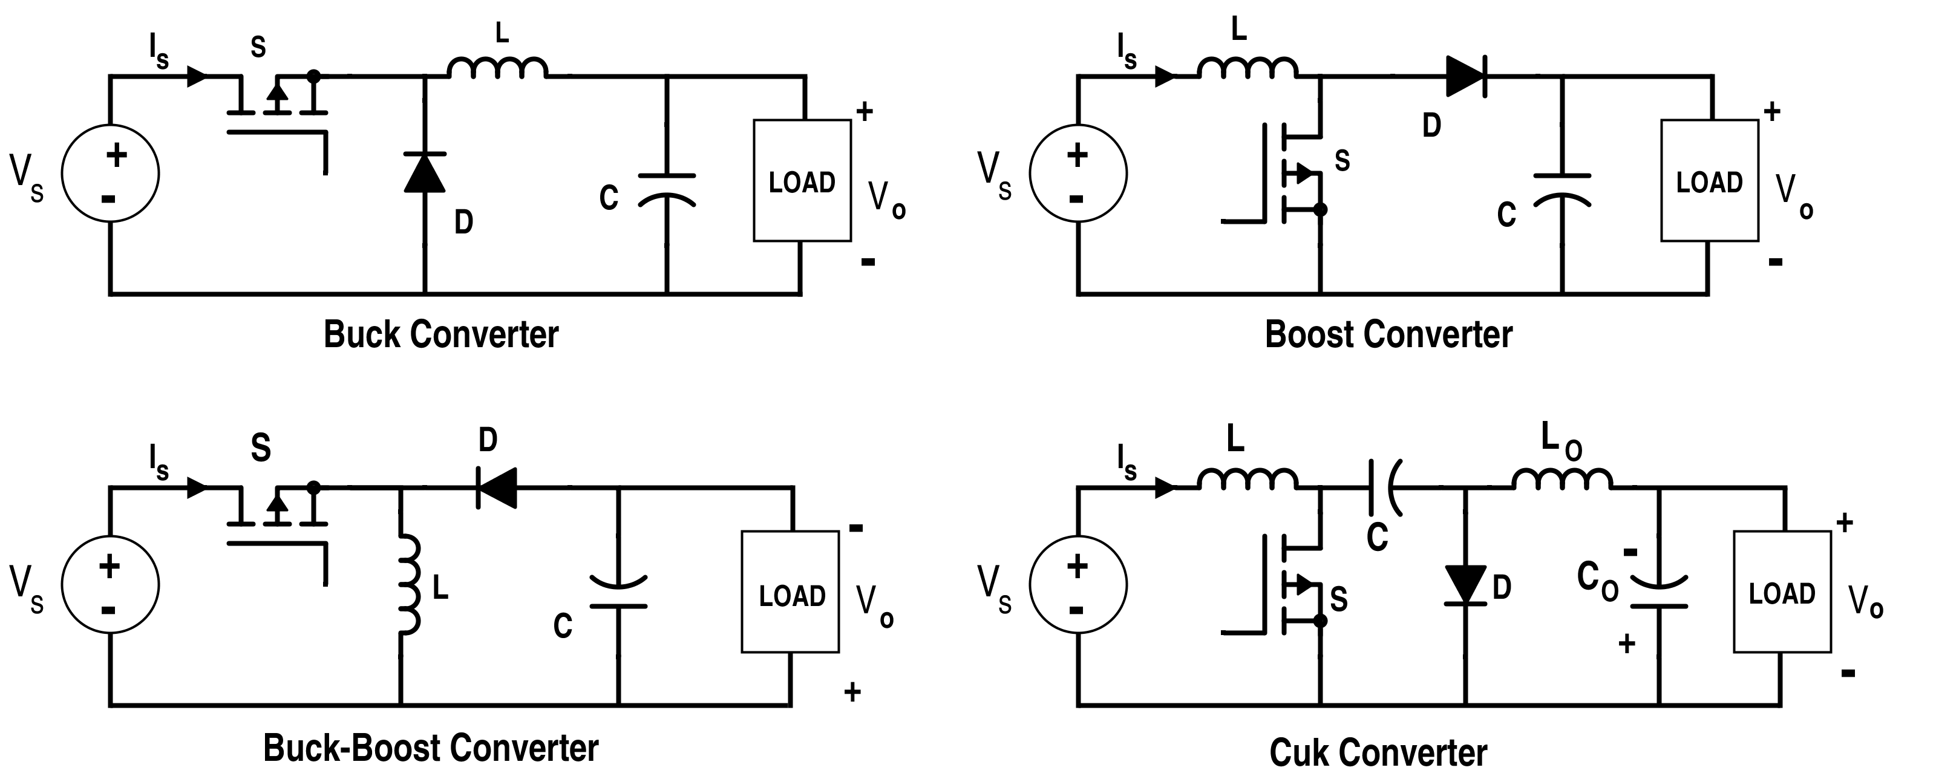
Buck, Boost, Buck/Boost
Slight modifications in the schematic, operation is quite different from the earlier buck explanation

Slide 21
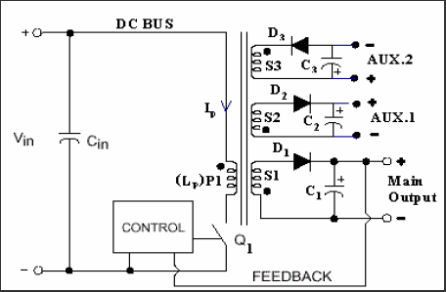
Flyback Converter
Transformer is used in place of an inductor
One or many outputs
Feedback loop (regulation) based on one output or some weighted average of multiple outputs

Slide 22
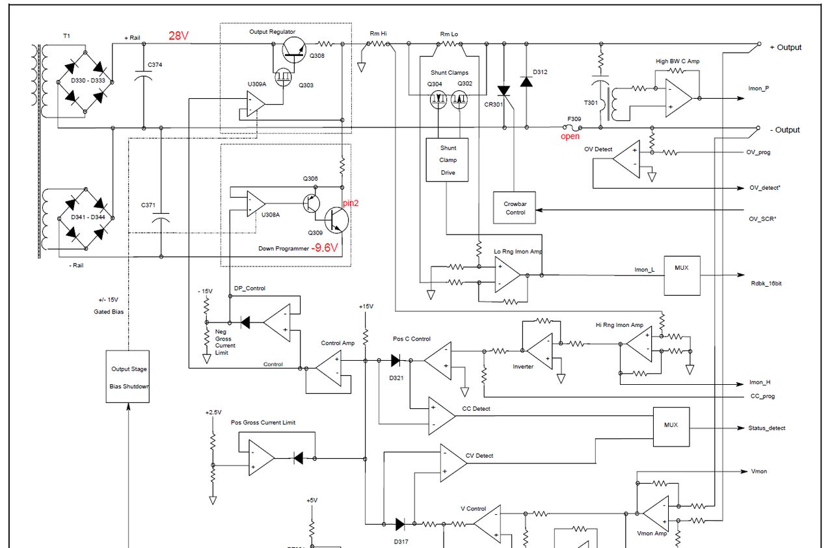
Agilent Bench Supply

Slide 23
DC-DC linear vs switching supplies
 | Pros/Cons
Switching (Regulated) | Easy to buy/use Typically preferred over ~1A of output current Typically overly-complicated for low power circuits (100’s of mW)
Linear Regulators | Easy to build, easy to buy Easy to integrate onto proto boards Becomes more difficult as P_{DISS} increases beyond a few watts Off-the-shelf options above 1A are limited

Slide 24
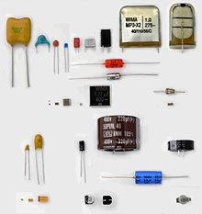
About Capacitors
Capacitance value
Physical size
Lead configuration (axial, radial)
Voltage rating
Polarized
Equivalent Series Resistance (ESR)
Equivalent Series Inductance (ESL)
Appropriate frequency range

Slide 25
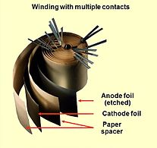
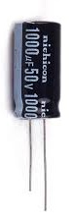
Electrolytic Capacitors
Electrolytic (Aluminum)
Primarily used for bulk capacitance, up to 10,000’s of µF
Lots of disadvantages:
Polarized (typically)
Need to check voltage rating, derate 20%
Physically large
High equivalent series resistance
High equivalent series inductance
Doesn’t look like a capacitor much above 100kHz
Electrolytic (solid tantalum)
Similar to aluminum electrolytic except:
Smaller
Better (lower) ESR, ESL
Frequency response to ~500kHz, maybe 1MHz
Derate voltage by 50%
Overvoltage or wrong polarity can cause a fire

Slide 26
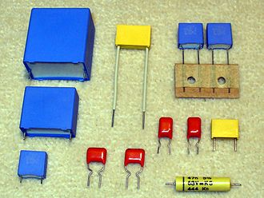
Ceramic Capacitors
Film
Often thought of as an alternative to ceramics for audio
Benefits:
Linear response
No microphonics
Slightly higher capacitance than ceramics
Good heat and vibration tolerance

Slide 27
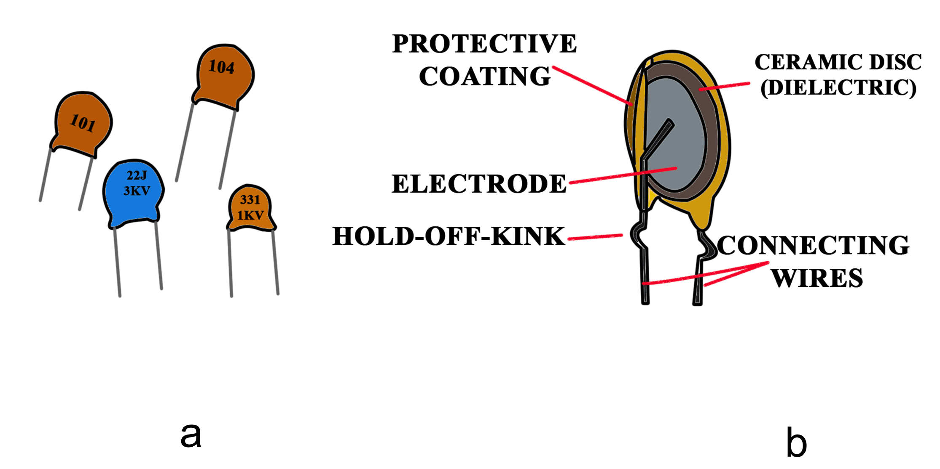
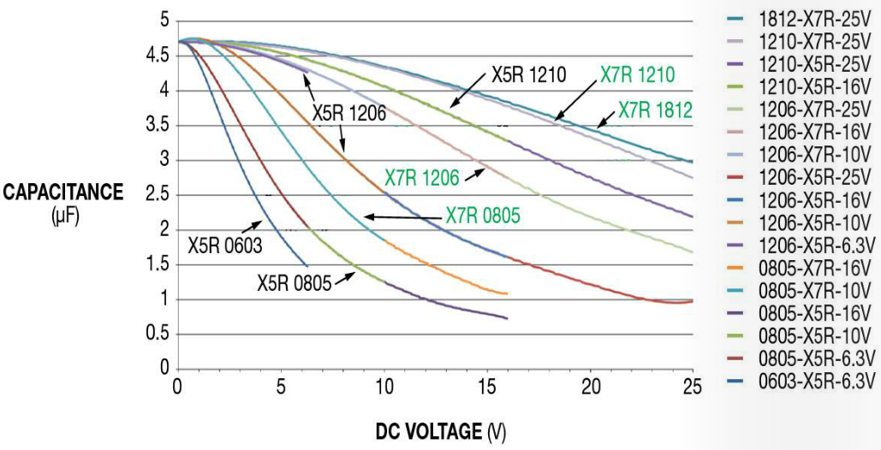
Film Capacitors
Ceramic
Looks the most like an ideal capacitor
Low capacitance value (1uF is a large ceramic cap)
Not polarized
High voltage ratings (typ 100V)
Very low equivalent series resistance
Very low equivalent series inductance
Frequency range, 10’s or 100’s of MHz
Capacitance is highly voltage dependent
~80% lower at rated voltage
Due to ferroelectric dipoles
Nonlinearity makes them less desirable in hifi audio
Piezoelectric

Slide 28
Bypass caps, rules of thumb
Where to put them
Where power enters a board
Near the V_{CC} pin of each IC
Input and output of linear regulator ICs
Values and types:
0.1uF ceramic is the workhorse for typical digital/analog
Maybe add a 10µF or so where power enters the board
AC rectifier circuits tend to use 1000’s of uF
Larger bypass caps are needed with:
Larger current swings
Lower frequency
Power supply feed lengths get longer
Star feed is better than daisy chain feed
Typical low current circuits -> 0.1uF ceramic cap every several inches

Slide 29
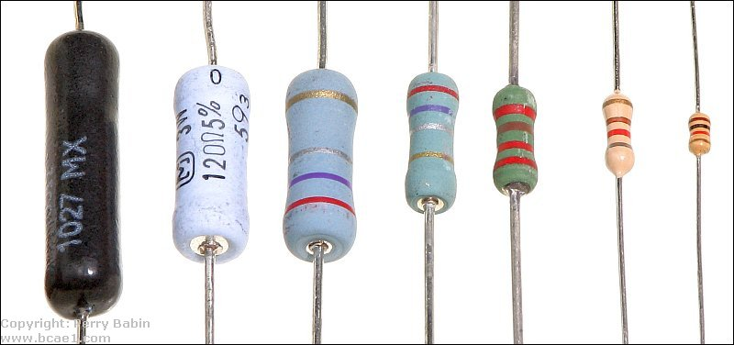
Measuring Current Draw of a Circuit
R_{SENSE}
I_{LOAD}
I_{LOAD} = V_{DROP} / R_{SENSE}
+ V_{DROP} -
+
Load
V_{SUPPLY}
V_{DROP} should be large enough for a multimeter to measure it accurately but not so large that it affects the circuit being powered
0.1V < V_{DROP} < V_{SUPPLY} / 10
3W
1W
1/4W
5W
2W
1/2W
1/8W
Check that resistor is rated for dissipated power
If it’s too hot to touch, measure fast
P_{DISS} = V_{DROP} x I_{LOAD}

Slide 30

Determining if you’ll run too hot
Build it, feel the device, if it’s too hot to touch for 0.5 seconds, add a heat sink, choose a larger regulator or do something else about it
Or, rules of thumb->

Slide 31
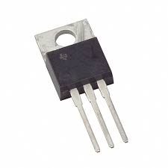
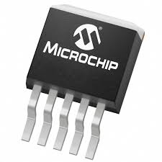
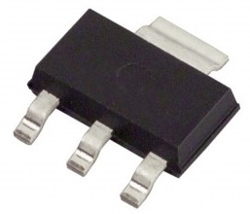
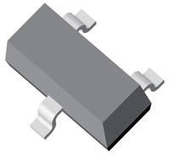
Thermal Rules of thumb based on packaging
Package | R_{JA} | Max Power No Heat Sink | Accommodates Heat Sink? | Picture
TO-220 | ~20 | ~2-4W | Yes
DDPAK | 44 | ~1-1.5W | No
SOT223 | 90 | ~0.5-0.7W | No
SOT23 | 200 | ~0.25W | No
Or, get your calculator out->

Slide 32
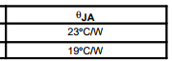
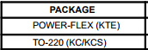
Calculate thermal limit for TO-220
40°C
P_{DISS,MAX} = (T_{J,MAX -} T_{AMBIENT,MAX}) / (R_{JA})
P_{DISS,MAX} = (110) / (19) = 5.8W
You need some margin on this. 3-4W might be OK

Slide 33
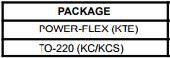
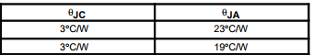
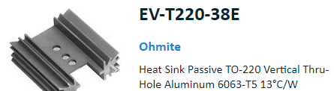
How much does a heat sink help?
P_{DISS,MAX} = (T_{J,MAX -} T_{AMBIENT,MAX}) / (R_{JC} + R_{CA})
P_{DISS,MAX} = (110) / (3+13) = 6.9W (compared to 5.8W bare)
~20% improvement, 4-5W
These numbers can be very rough:
Air flow around part/heat sink
Surface mount parts can be highly affected by PCB layout
Rules of thumb:
TO-220 is good for 2-4W of power w/o heat sink, can be improved to 4-5W easily, significantly more requires very large heat sinks and/or fan cooling
SMT is good for 0.25W to 2.5W depending on part, package and PCB layout

Slide 34
Appendix

Slide 35
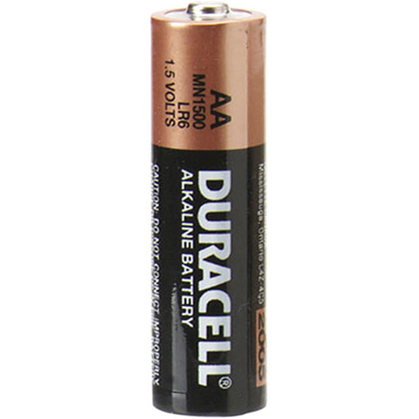
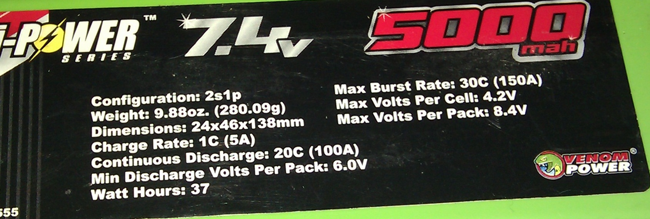
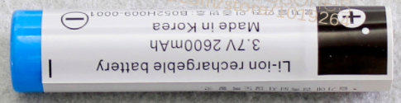
A Quick Battery Primer
Important battery terms:
Voltage, e.g. 1.5V
Voltage range, 0.9 to 1.5V
Capacity, e.g. 500mAh
Discharge rate, e.g. 10C
High current applications - Killswitch
Proper schematic for a single cell
+
+

Slide 36
Series vs Parallel Batteries
Batteries in series:
Multiply voltage, capacity stays the same
Batteries in parallel:
Multiply capacity, voltage stays the same
Series combination yields
4.5V @ 2800mAh
Parallel combination yields
1.5V @ 8400mAh
1.5V 2800mAh
+
+
1.5V 2800mAh
+
+
+
+
1.5V 2800mAh

Slide 37
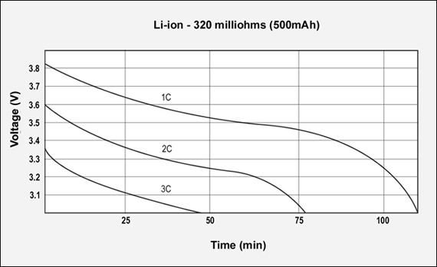
Battery discharge curve This is the primary challenge
Chemistry
Capacity
Rated as “3.6V”
Discharge rates
1C = 500mA
2C = 1000mA
3C = 1500mA

Slide 38
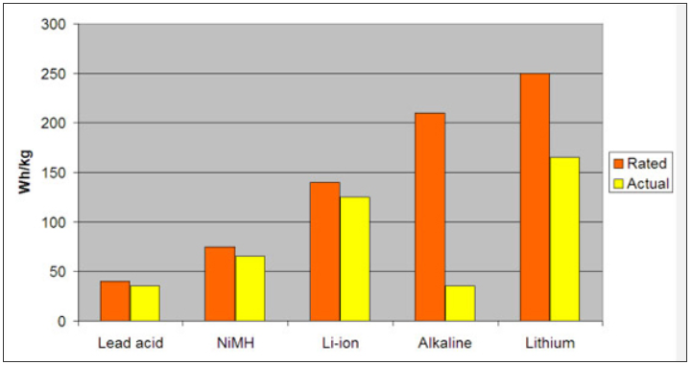
Battery Chemistry Comparison
Rated: low discharge current
Actual: 1C discharge current
http://batteryuniversity.com/learn/article/primary_batteries

Slide 39
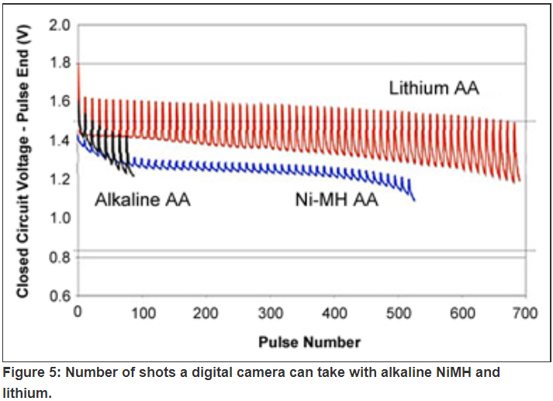
Battery internal resistance
Remember Ohm’s law:
V = I x R
Battery voltage depends on current
Might matter for higher current circuits
Battery model
Ri
I
+
Load
1.5V

Slide 40
Powering off of Batteries
Options:
Operate directly off battery if circuit allows
Stack batteries and regulate down to desired voltage
Buck-boost regulator if battery voltage range straddles desired voltage
Low dropout linear regulators (e.g. 0.2V vs 1.0V) can significantly improve battery life
Battery Configuration | Voltage Range
3 alkaline cells | 2.7V to 4.5V
4 alkaline cells | 3.6V to 6.0V
9v cell | 4.8V to 9.0V
3 NiCd cells | 3.3V to 4.2V
NiMH | Similar to alkaline
1 Li+ (Li ion) cell | 2.8V to 4.2V

Slide 41
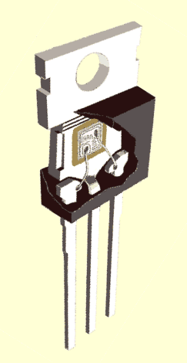
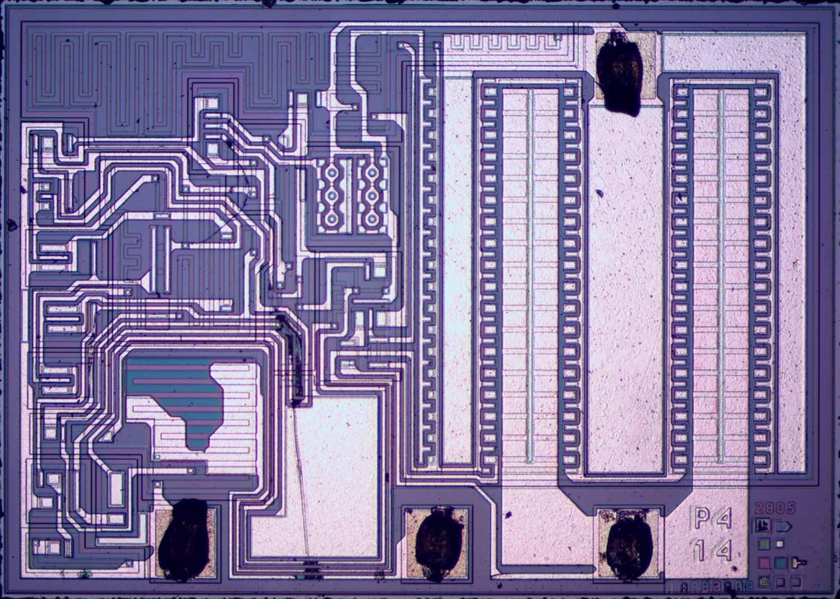
Thermal Management
First, a Fun Look Inside the LM7805
LM7805

Slide 42
LM7805 Die
Capacitor
http://www.righto.com/2014/09/reverse-engineering-counterfeit-7805.html

Slide 43
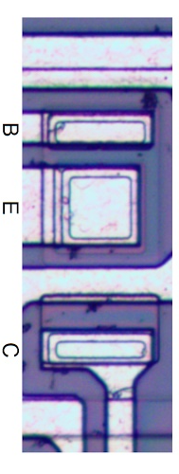

Thermal Management What are we protecting?
LM7805
Thermal management is about protecting this from overheating

